Slide 1

Paper Update
Major update and new findings

Slide 2
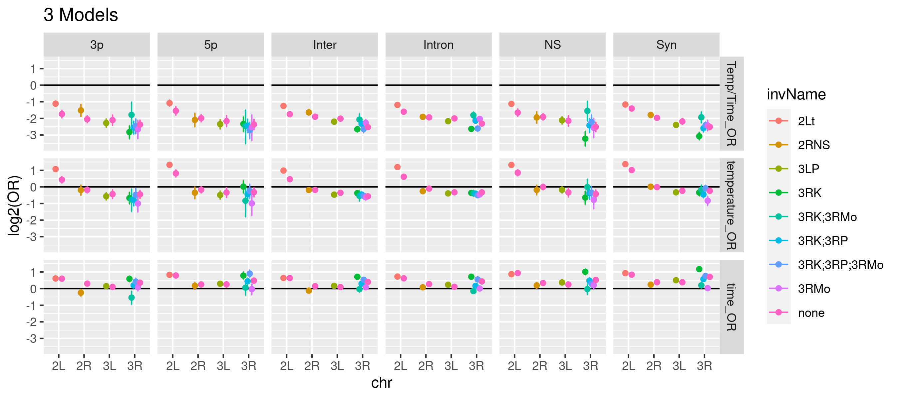

Slide 3
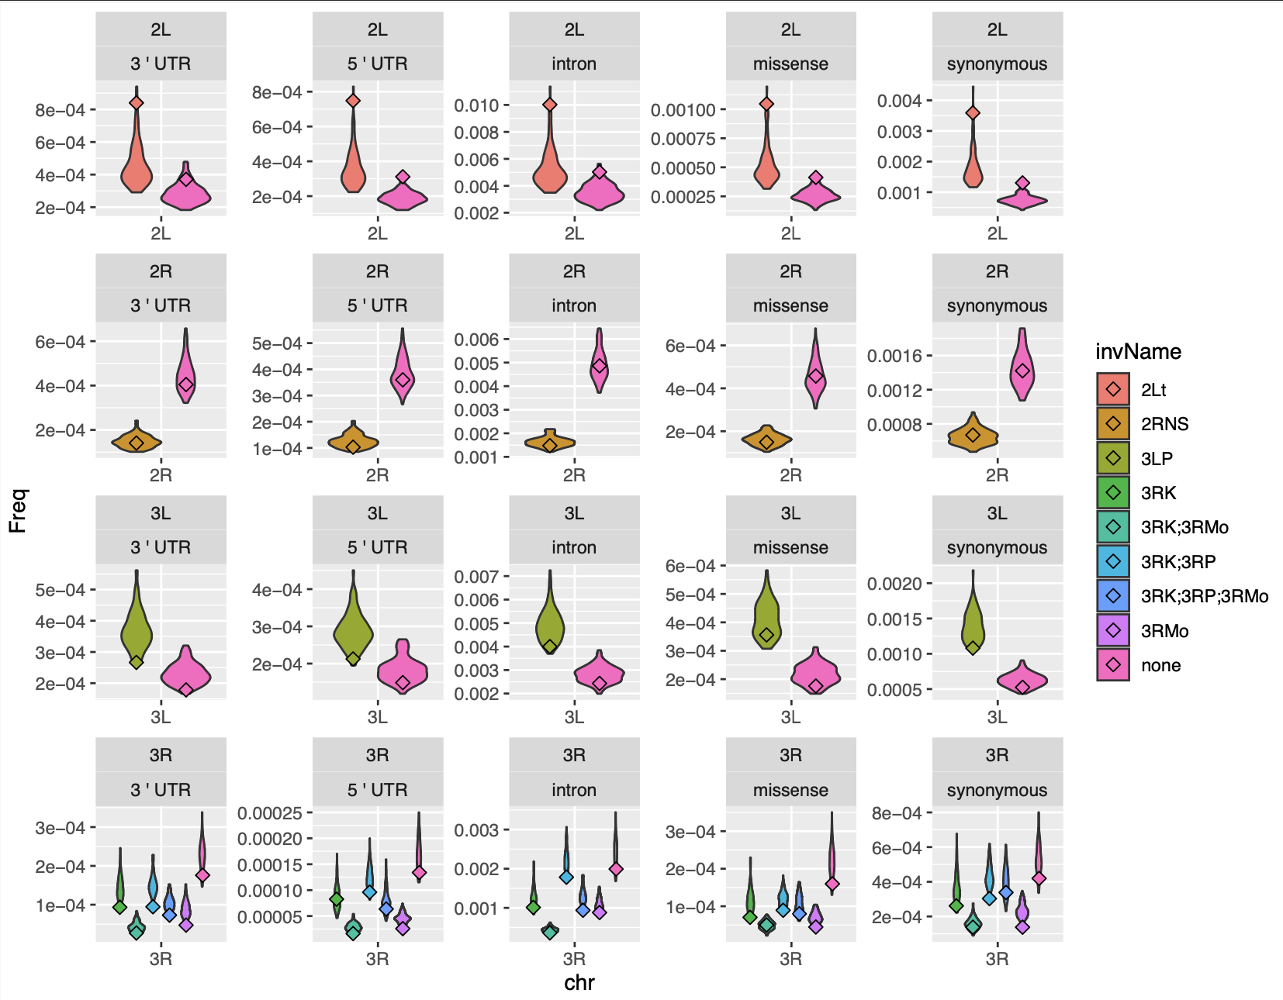

Slide 4
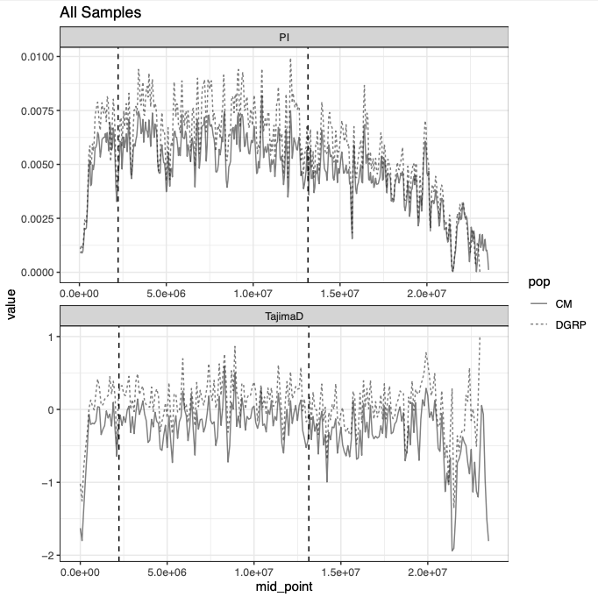

Slide 5
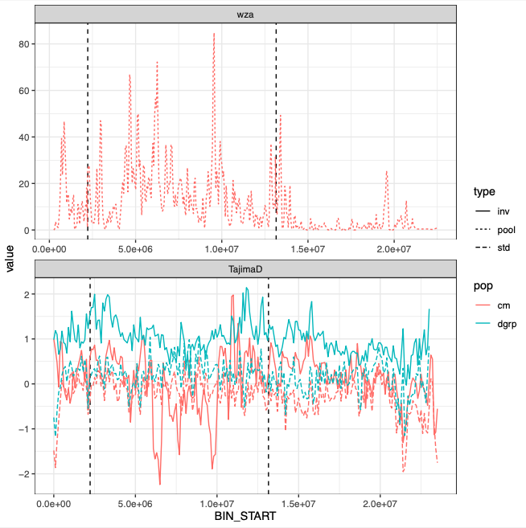

Slide 6
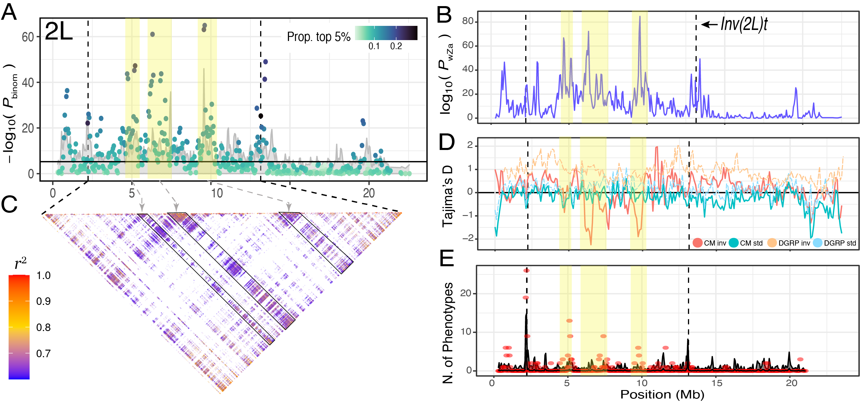

Slide 7
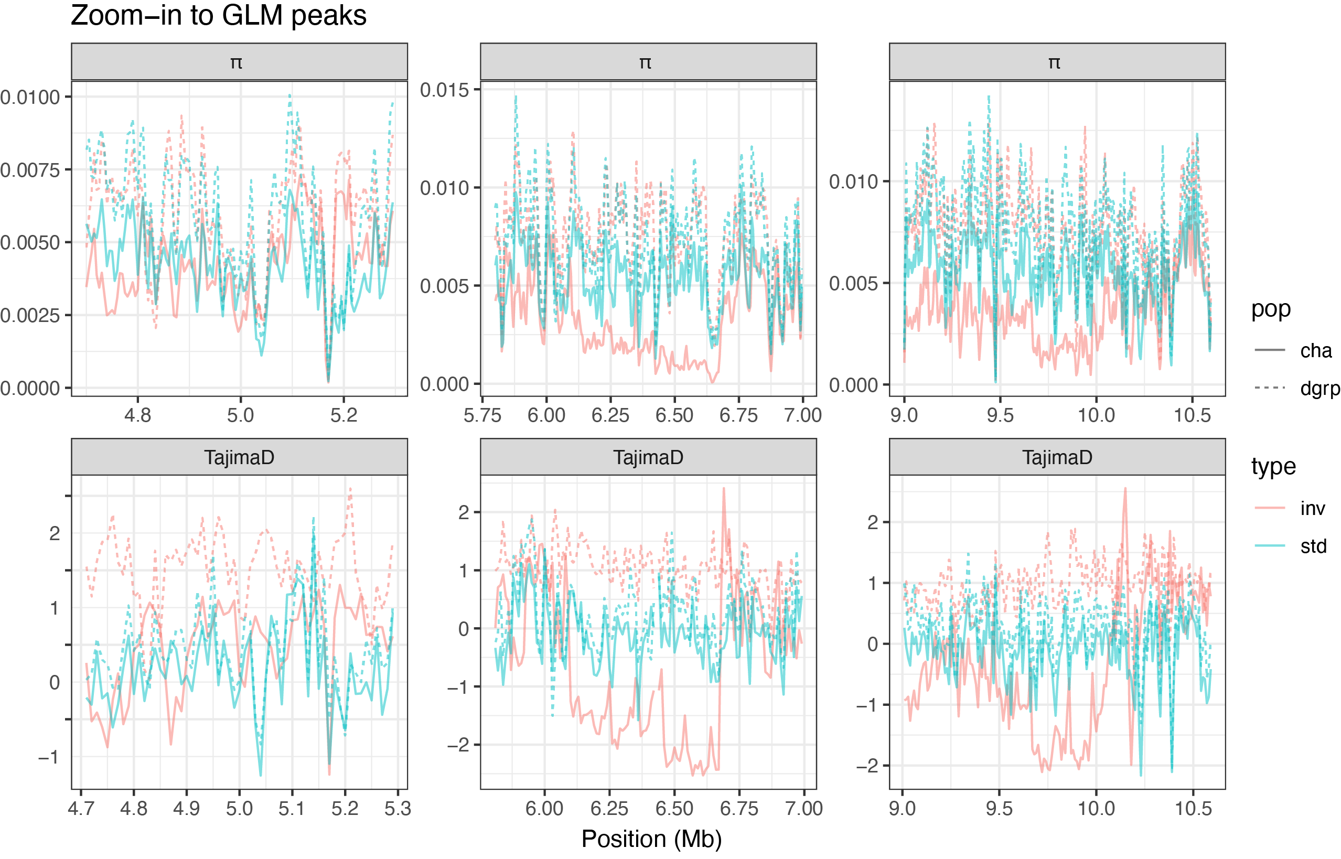

Slide 8
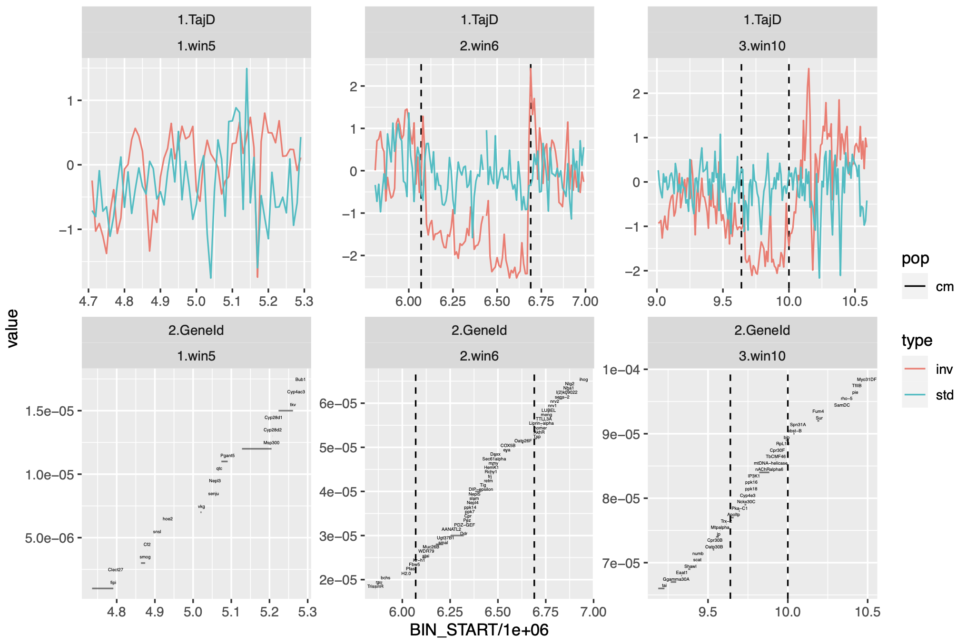

Slide 9
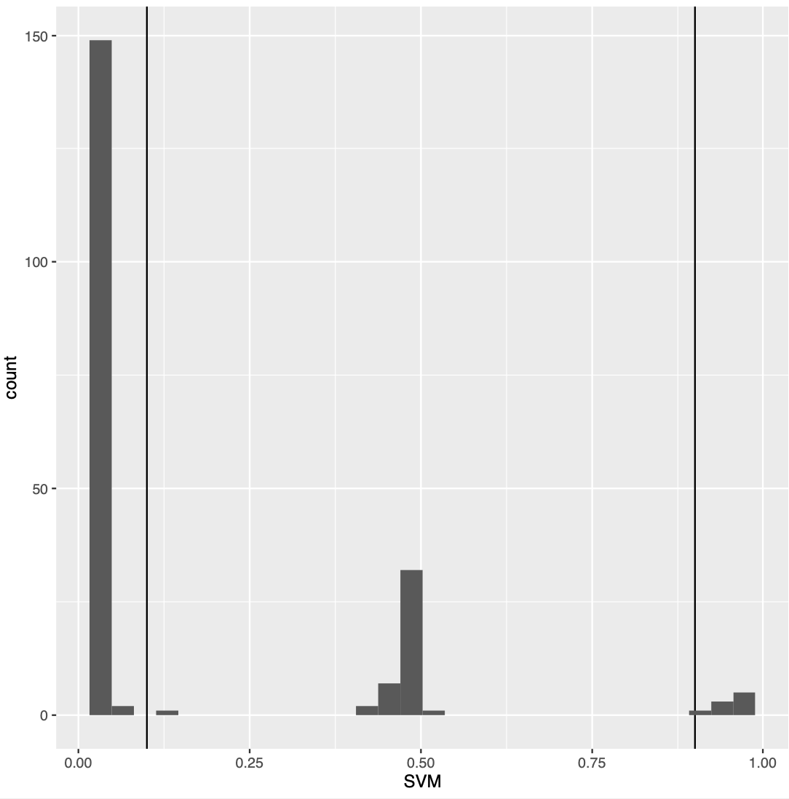
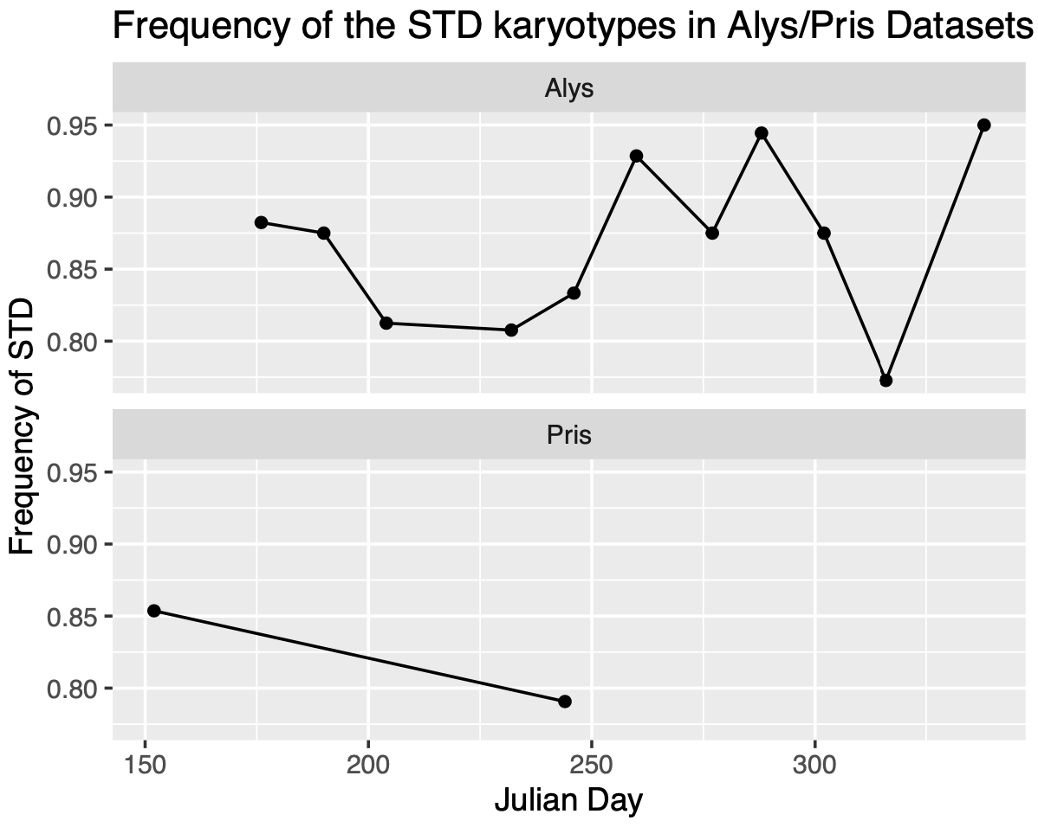
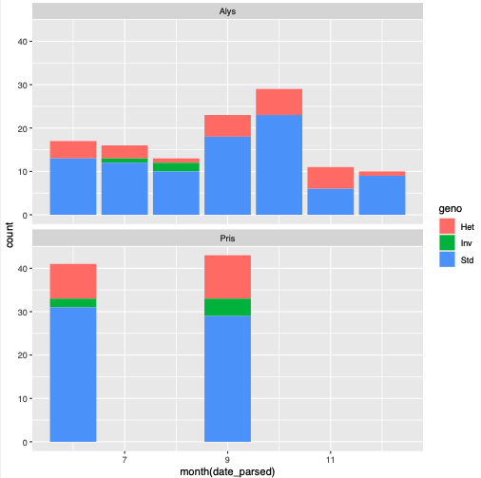

Slide 10
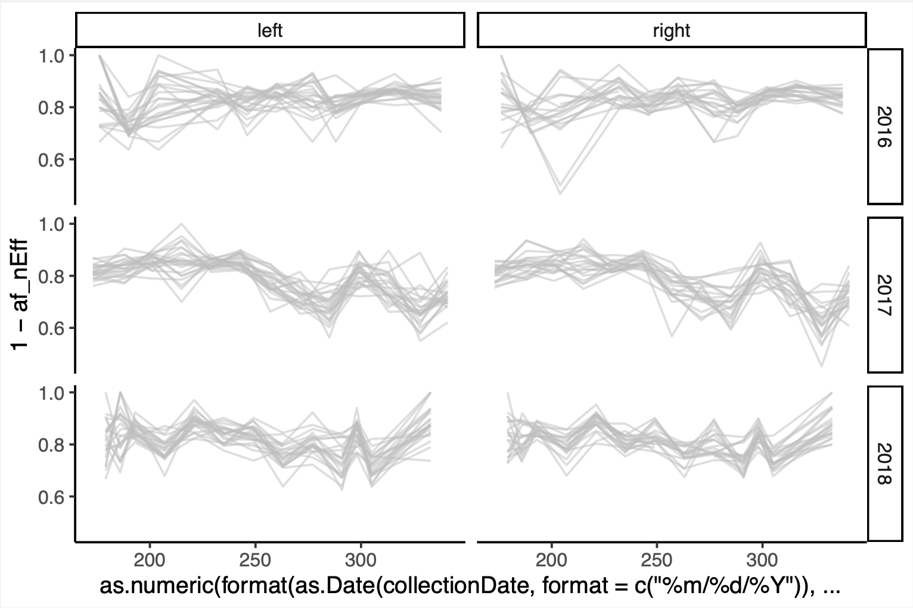
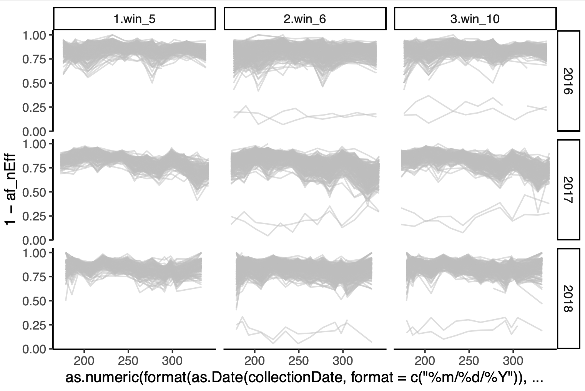

Slide 11
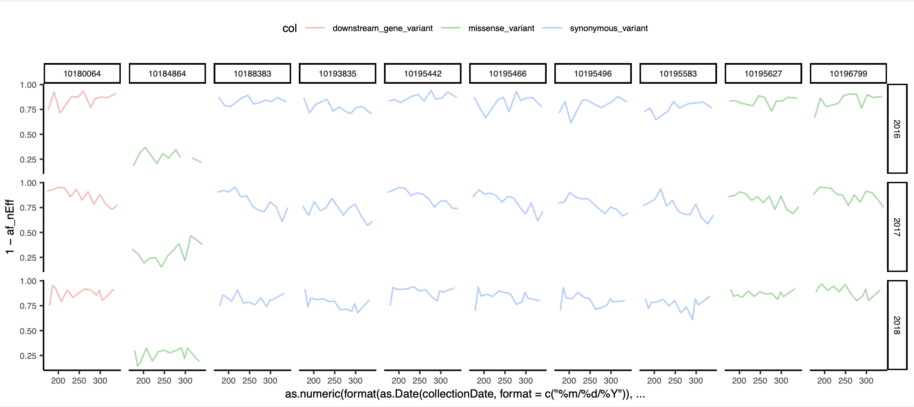
Hydrophobic to polar
p.Ile1878Asn
Sulfonylurea receptor (Sur)
Notes:
10184864

Slide 13
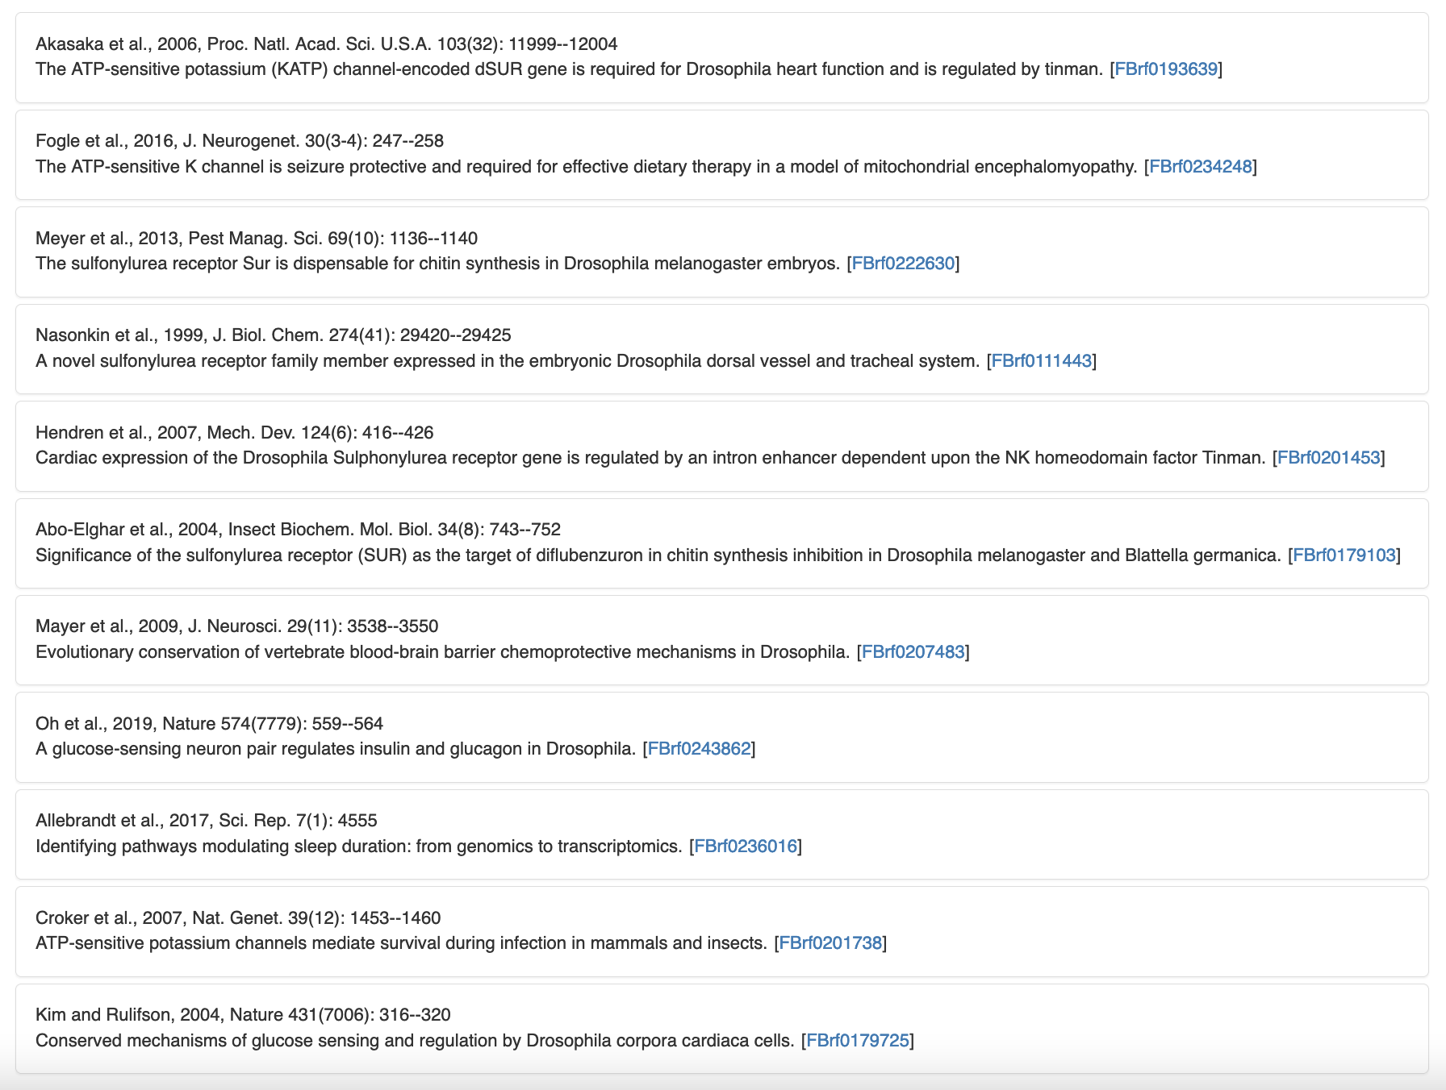
Sulfonylurea receptor (Sur) encodes a predicted ATP-sensitive K[+] channel expressed almost exclusively in the embryonic heart. Sur loss in the adult heart causes increased oxidative stress and pacing-induced heart failure. [Date last reviewed: 2019-03-14]. Predicted to enable ATPase-coupled transmembrane transporter activity. Involved in response to hypoxia.

Slide 14
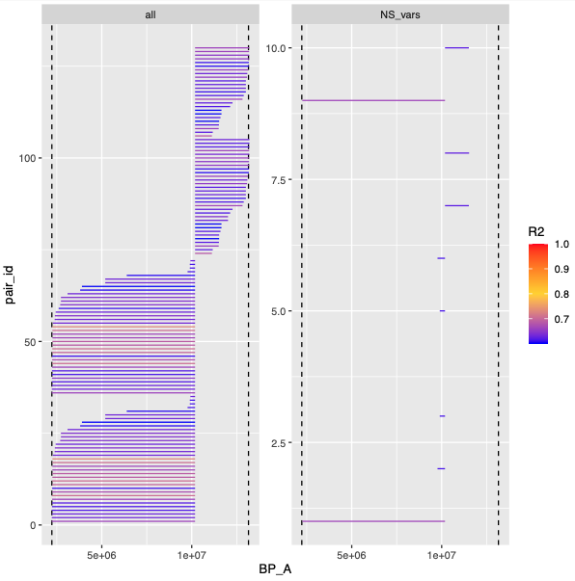
"CG17234" "CG4017" "mtDNA-helicase" "Sur"
"Dlg5" "CG31705"

Slide 15
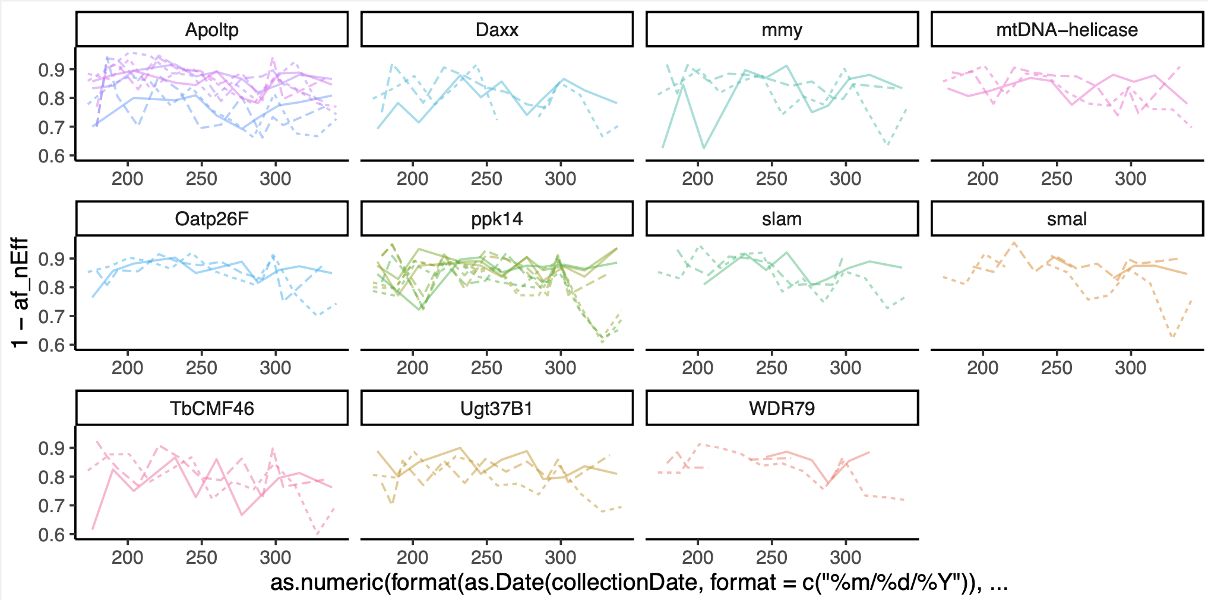
Glu189Asp
3 radical changes
Same Charge (-)
Ala4Ser
Gln584His
All hydrophobic
Ala9Pro
Hydrophobic to polar
uncharged to ⁺charge
Hydrophobic to hydrophobic sp*
Slam
Oatp26F
Apoltp

Slide 16
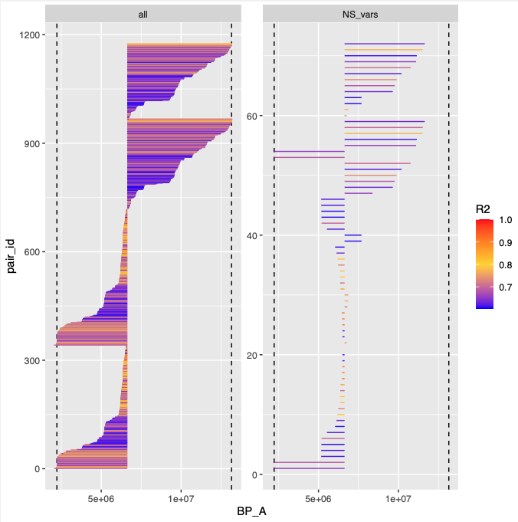
"Tengl2" "CG17234" "Msp300" "CG31915"
"CG31643" "WDR79" " smal" "Ugt37B1"
"ppk14" "slam" "mmy" "Daxx"
"CG9547" "CG9550" " Oatp26F" "LUBEL"
"l(2)k09022" "CG7025" "Apoltp" "CG4017"
"mtDNA-helicase" "Sur" "CG6495" "l(2)gd1"
"CG6287" "Dlg5" "CG6614" "CG11236"
"Rcd4" "CG31705"
0.7
Oatp26F
mtDNA-helicase
Apoltp
smal

